Slide 1
KUBERNETES

Slide 2
SOFTWARE DEVELOPMENT AND DEPLOYMENT
Software applications were big monoliths.
Running either as a single process or as a small number of processes spread across a handful of servers.
These legacy systems are still widespread today.
They have slow release cycles and are updated relatively infrequently.
At the end of every release cycle, developers package up the whole system and hand it over to the ops team, who then deploys and monitors it.
Today, these big monolithic legacy applications are slowly being broken down into smaller, independently running components called microservices.

Slide 3
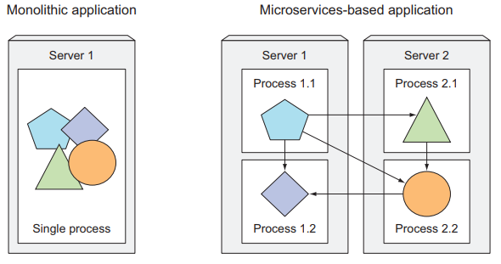
SPLITTING APPS INTO MICROSERVICES

Slide 4
Microservices
Microservices communicate through synchronous protocols such as HTTP.
Each microservice is a standalone process with a relatively static external API.
It’s possible to develop and deploy each microservice separately.

Slide 5
SCALING MICROSERVICES
Scaling microservices, unlike monolithic systems.
In monolithic apps need to scale the system as a whole.
In Microservices you have the option of scaling only those services that require more resources. while leaving others at their original scale.

Slide 6
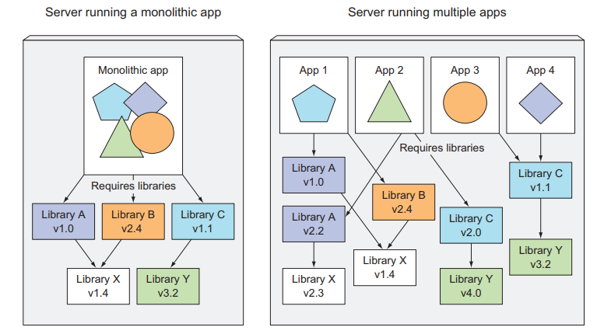
MONOLITHIC VS MULTIPLE APPS

Slide 7
Kubernetes
Kubernetes is a software system that allows you to easily deploy and manage containerized applications on top of it.
Kubernetes enables you to run your software applications on thousands of computer nodes as if all those nodes were a single, enormous computer.
It abstracts away the underlying infrastructure and, by doing so, simplifies development, deployment, and management for both development and the operations teams.
Deploying applications through Kubernetes is always the same, whether your cluster contains only a couple of nodes or thousands of them.

Slide 8
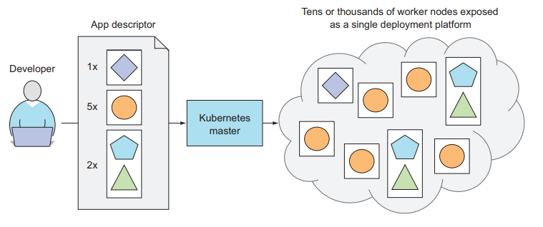
KUBERNETES IN-DEPTH

Slide 9
KUBERNETES IN-DEPTH
The system is composed of a master node and any number of worker nodes.
A node is a worker machine in Kubernetes, previously known as a minion.
A node may be a VM or physical machine, depending on the cluster.
Each node has the services necessary to run pods and is managed by the master components
When the developer submits a list of apps to the master, Kubernetes deploys them to the cluster of worker nodes. What node a component lands on doesn’t (and shouldn’t) matter—neither to the developer nor to the system administrator.

Slide 10
KUBERNETES IN-DEPTH
Kubernetes can be thought of as an operating system for the cluster.
Kubernetes relieves application developers from having to implement certain infrastructure-related services into their apps; instead they rely on Kubernetes to provide these services.
This includes things such as service discovery, scaling, load-balancing, self-healing, and even leader Kubernetes master.

Slide 11
Architecture of a Kubernetes cluster
Kubernetes cluster is composed of. At the hardware level, a Kubernetes cluster is composed of many nodes, which can be split into two types:
The master node, which hosts the Kubernetes Control Plane that controls and manages the whole Kubernetes system.
Worker nodes that run the actual applications you deploy

Slide 12
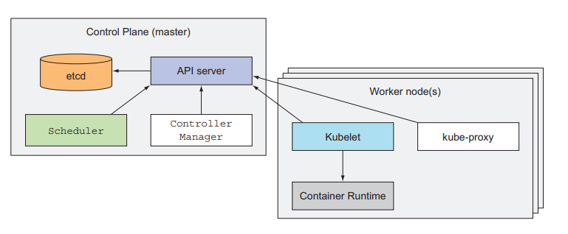
Architecture of a Kubernetes cluster

Slide 13
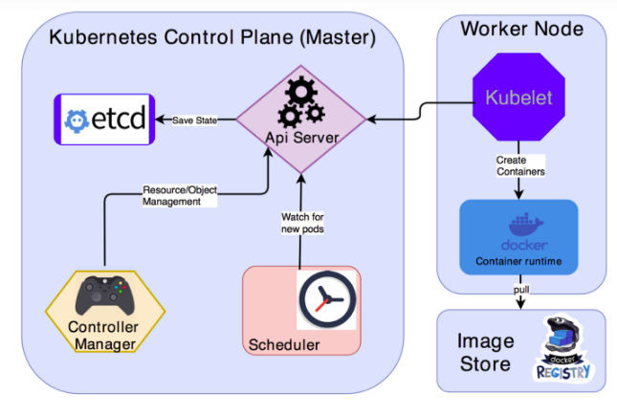
Architecture of a Kubernetes cluster

Slide 14
Architecture of a Kubernetes cluster
Kubernetes cluster consists of two main components.
Master (Control Plane)
Worker Nodes

Slide 15
Architecture of a Kubernetes cluster
Control Plane
The Control Plane is what controls the cluster and makes it function.
It consists of multiple components that can run on a single master node or be split across multiple nodes and replicated to ensure high availability.
The Kubernetes API Server
which you and the other Control Plane components communicate with
The Scheduler
which schedules your apps (assigns a worker node to each deployable component of your application).
The Controller Manager
which performs cluster-level functions, such as replicating components, keeping track of worker nodes, handling node failures, and so on.

Slide 16
Architecture of a Kubernetes cluster
etcd
a reliable distributed data store that persistently stores the cluster configuration.
The components of the Control Plane hold and control the state of the cluster, but they don’t run your applications. This is done by the (worker) nodes.
THE NODES
The worker nodes are the machines that run your containerized applications. The task of running, monitoring, and providing services to your applications is done by the following components: Docker, rkt, or another container runtime, which runs your containers
The Kubelet, which talks to the API server and manages containers on its node.

Slide 17
Running an application in Kubernetes
Run an application in Kubernetes, first need to package it up into one or more container images.
Push those images to an image registry
Post a description of your app to the Kubernetes API server.
The description includes information such as the container image or images that contain your application components.

Slide 18
MINIKUBE
Minikube is a tool which provides a way to run kubernetes on your local machine.
It simply takes a docker image ( an immutable file, created using build command) and run it using kubectl (kubectl is a command line interface for running commands against Kubernetes clusters).
Minikube is use to test it for development. It cannot be used on production cluster.
It’s a single node machine with no high availability.
A good news is that it works on Mac, Linux and windows.
kubectl expose deployment nginx1 --port=8080 --target-port=80 --type=NodePort

Slide 19
THANKS

